Slide 1

Excel Final ASSESMENT
Kamalakannan S

Slide 2
Question 1
Data Cleaning:
The dataset has been cleaned by removing the duplicate records and the blanks in the dataset has been filled as “NA”
in the comment section using Find and Replace.

Slide 3
Question 2
The time gap between the publish date and the trending date of the video has been found using formula
Formula Used: =B2-F2
Trending date – Publish date
The average time gap for a video to trend is found to be approximately 2.3 days
Formula used: =AVERAGE(Q2:Q16308)

Slide 4
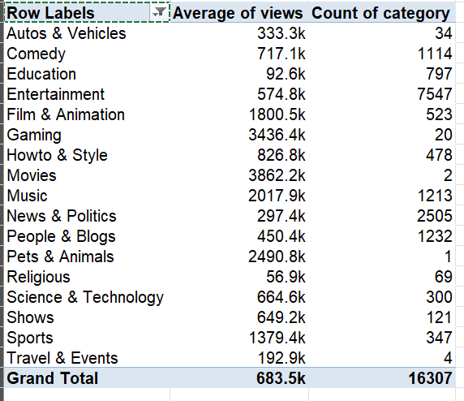
Question 3
Videos have been grouped according to their categories using the pivot table.
And then the average views of respective categories have been found.

Slide 5
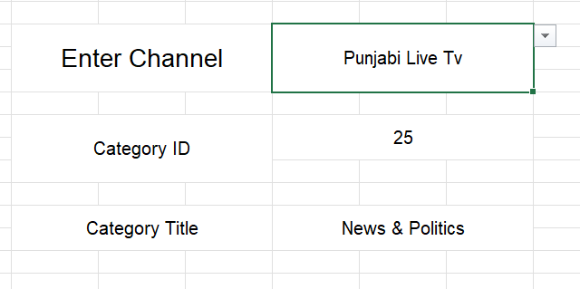
Question 4
A way to filter the unique channel name has been created using data validation function.
Used XLOOKUP to find the appropriate name of the category ID
Formula Used: =XLOOKUP(F8,Category!A:A,Category!B:B,"NA")

Slide 6
Question 5
The title and channel title cloumns have been concatenated to form a new column using concate function.
Formula used:
=CONCAT('YouTube data'!C2,"-",'YouTube data'!D2)
Used textjoin function to join each video coment into a single cell.
Formula used:
=TEXTJOIN(" , " ,TRUE,Q:Q)

Slide 7
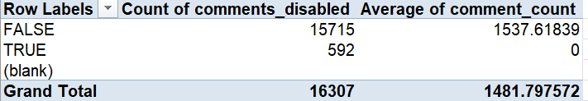
Question 6
The videos have been grouped based on comments_disabled criteria and their average has been taken using pivot table.

Slide 8
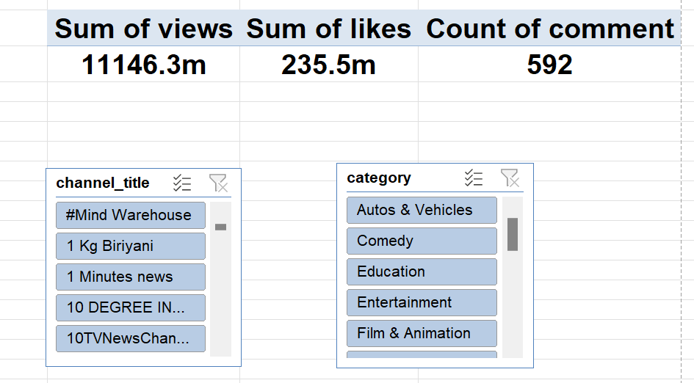
Question 7
Cards have been created using pivot tables based on likes, views and comments.
Slicers have been added for dynamic filtering.

Slide 9
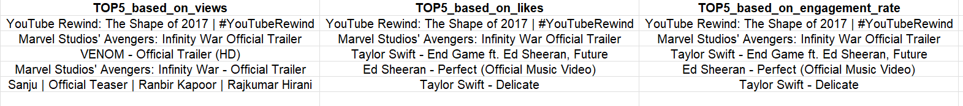
Question 8
Filters have been applied for each category in the dataset and the top 5 performing videos for appropriate criteria have been found.

Slide 10
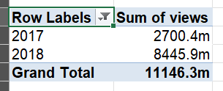
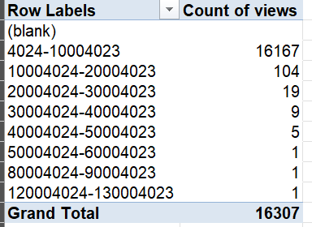
Question 9
Analysing the publish dates of the videos using pivot table
2018 had higher views compared to 2017.
Analysing the views of videos using pivot table.

Slide 11
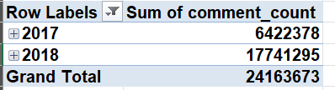
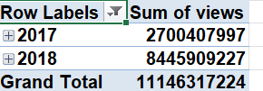
Question 10
The comments of videos published in 2018 have increased by 276% compared to 2017.
The views of videos have increased by 312% from 2017.

Slide 12
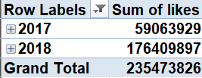
Question 11
The retention rate has increased in 2018.
The retention rate is found to be 2.9

Slide 13
Question 12
Considering the ad revenue rate for a video to be 0.5rs per view.
The ad revenue for each video has been computed using the formula.
Formula used: =0.5*G2
The most viewed video YouTube Rewind: The Shape of 2017 | #YouTubeRewind generated 62716118.5rs.

Slide 14
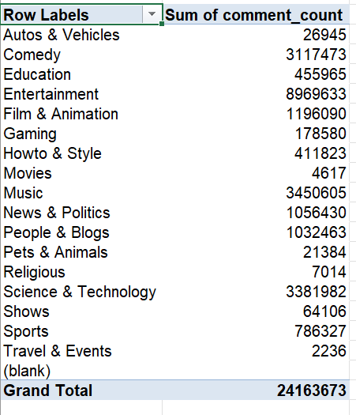
Question 13
The sentiment analysis has been done using pivot table.
Entertainment has the highest comment count
Travel and Events has the least count

Slide 15
Question 14
The engagement factors have been grouped according to categories using pivot table.

Slide 16
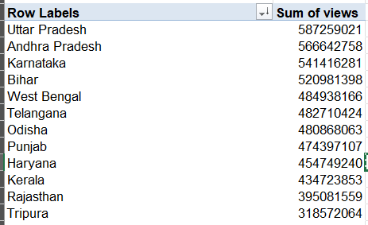
Question 16
Geographically views have been filtered
Uttar Pradesh has the highest number of views.

Slide 17
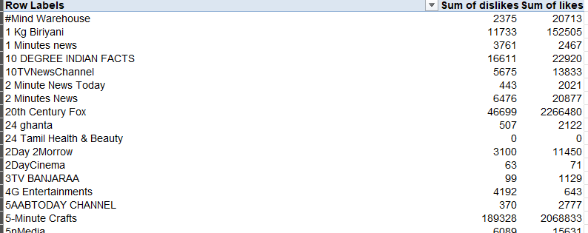
Question 18
Likes and Dislikes have been gruped according to the channel types using pivot table.

Slide 18
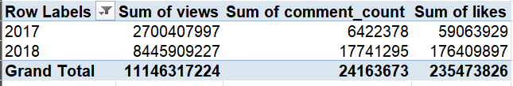
Question 19
Likes, views and comments have been grouped periodically using pivot table.

Slide 19
Question 19
Likes, views and comments have been grouped periodically using pivot table.

